Slide 1

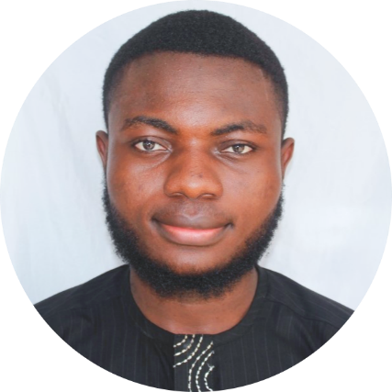

SANUSI, MUSTAPHA BABANSORO
B.Sc. Graduate
Nationality: NIGERIAN
Application No: 20241200232
Prospective Supervisor: Prof. Sun Guolin
Date: 14th March 2025
SB Mustapha | LinkedIn

Slide 2





ACADEMIC BACKGROUND
High School Attended
High School Graduated
B.Sc. in Software Engineering,
Al-Hikmah University, Nigeria (2020–2024)
M.Eng. (Prospective) – Computer Science and Technology.
University of Electronic Science and Technology of China (UESTC)
– Applying for 2025 Intake
Beijing World Youth Academy, China
(2017 – 2019)
Key Special Academy, Abuja, Nigeria
(2019 – 2020)
Software Architecture
Development & Testing
AI Fundamentals
Computational Logic
Graduation Project: Development of a Campus Navigation and Dynamic Display System.
Chinese
Mathematics
ICT
Science
English
Mathematics
ICT
Science
English
Data Processing
M.Eng. Thesis – TBD

Slide 3


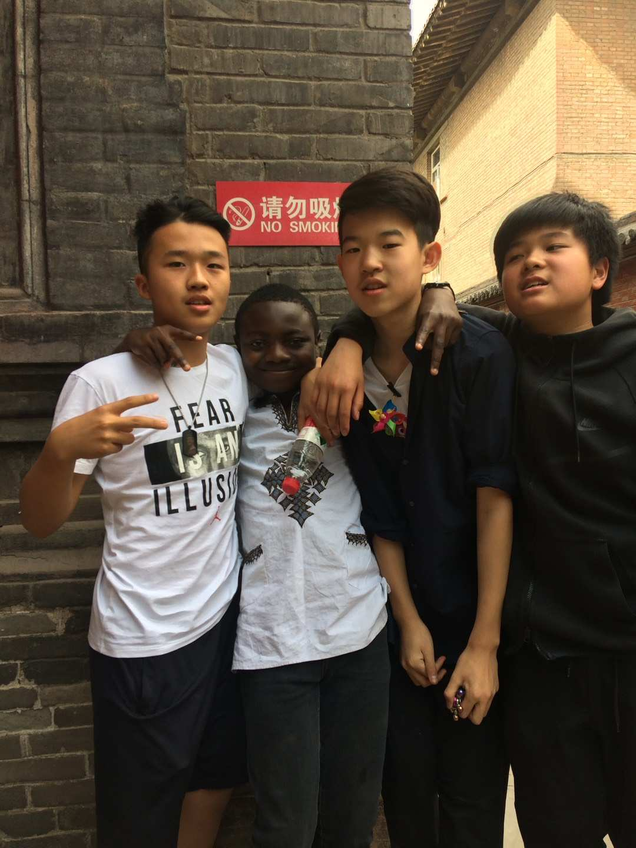
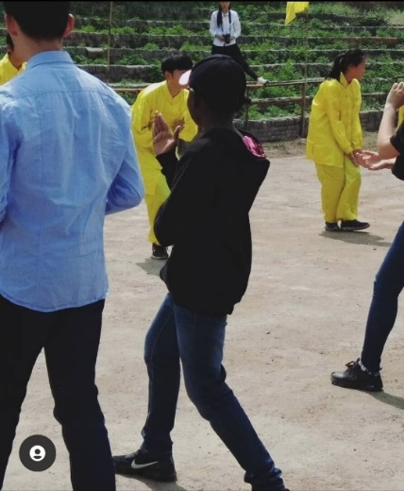
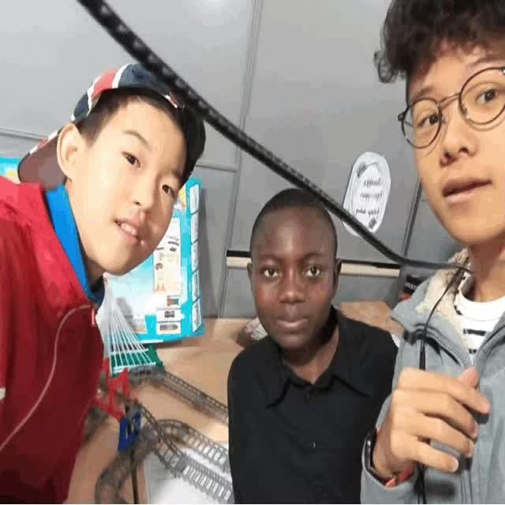
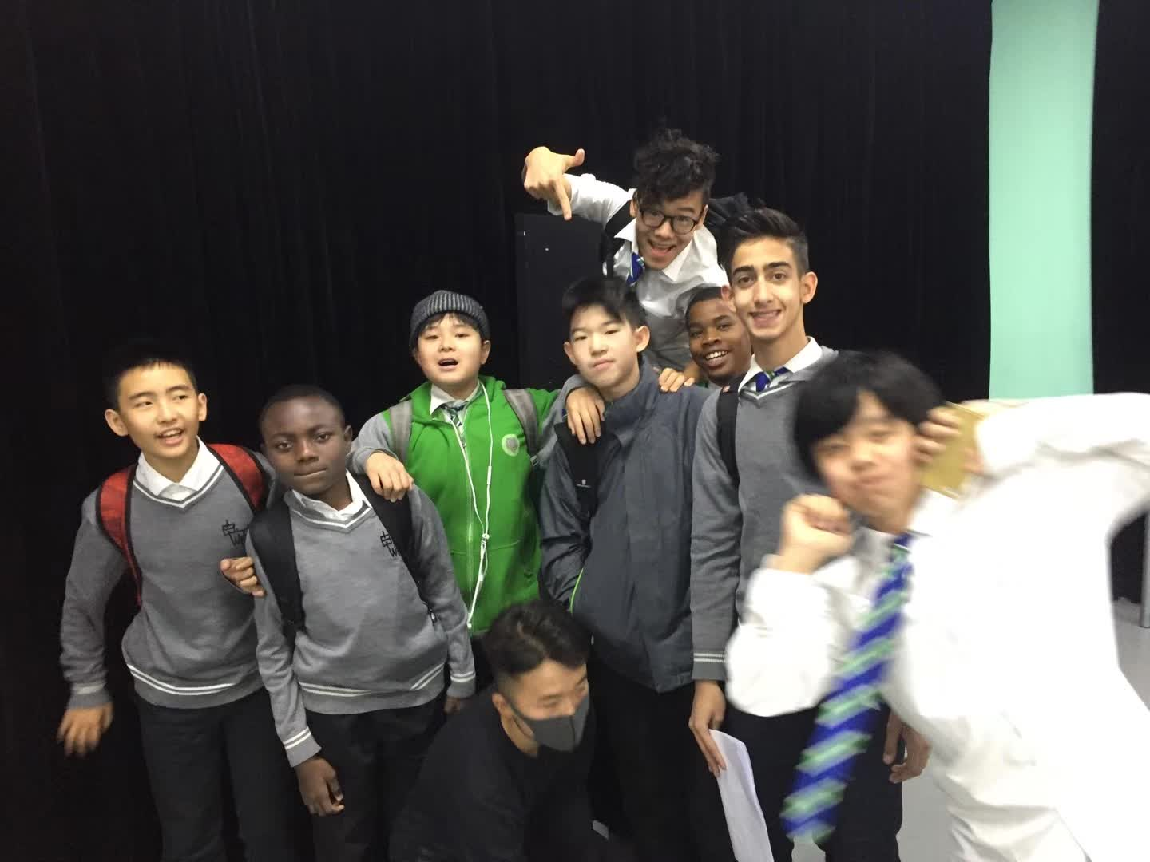
MY TIME IN CHINA
Having previously studied in China and with my father working at the Nigerian Embassy in Beijing, I have a deep understanding of the culture and academic environment.
I had the opportunity to visit Pingyao Ancient City in Shaanxi Province with my classmates, further immersing myself in the culture and history.

Slide 4




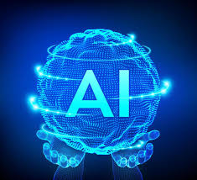




SKILLS
Hard Skills:
AI/ML, Deep Learning, Model Optimization, Data Science, Big Data Analytics,
Full-Stack Development, Cross-Platform Mobile Development, DSA, Database Management, Data Engineering.
Design, Modelling and Programming tools:
Python, Pandas, NumPy, TensorFlow, PyTorch, React Native, JavaScript.
Languages:
English (Fluent), Hausa (Native), Chinese (Basic)
COMMUNICATION
PROBLEM SOLVING
TEAM ORIENTED
LEADERSHIP
ANALYTICAL

Slide 5


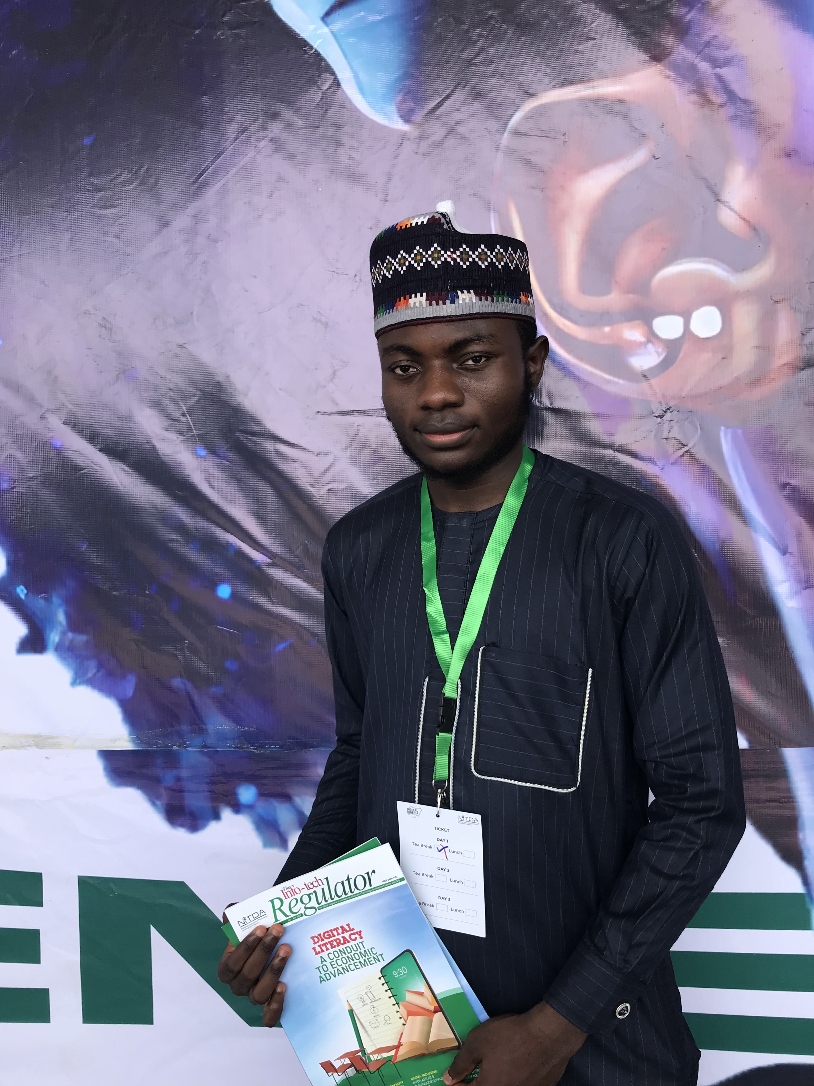
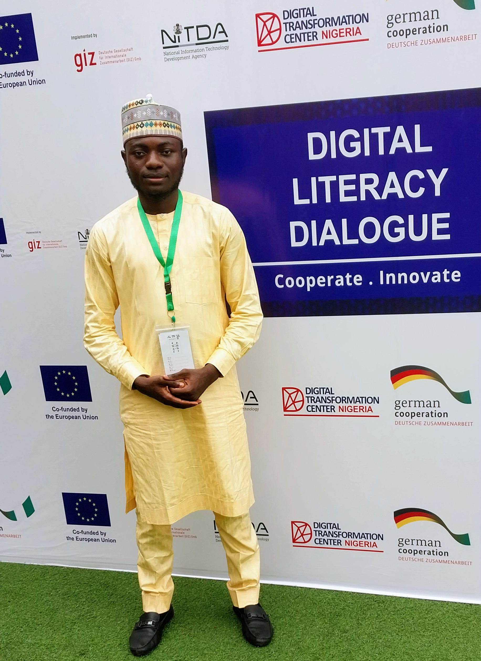
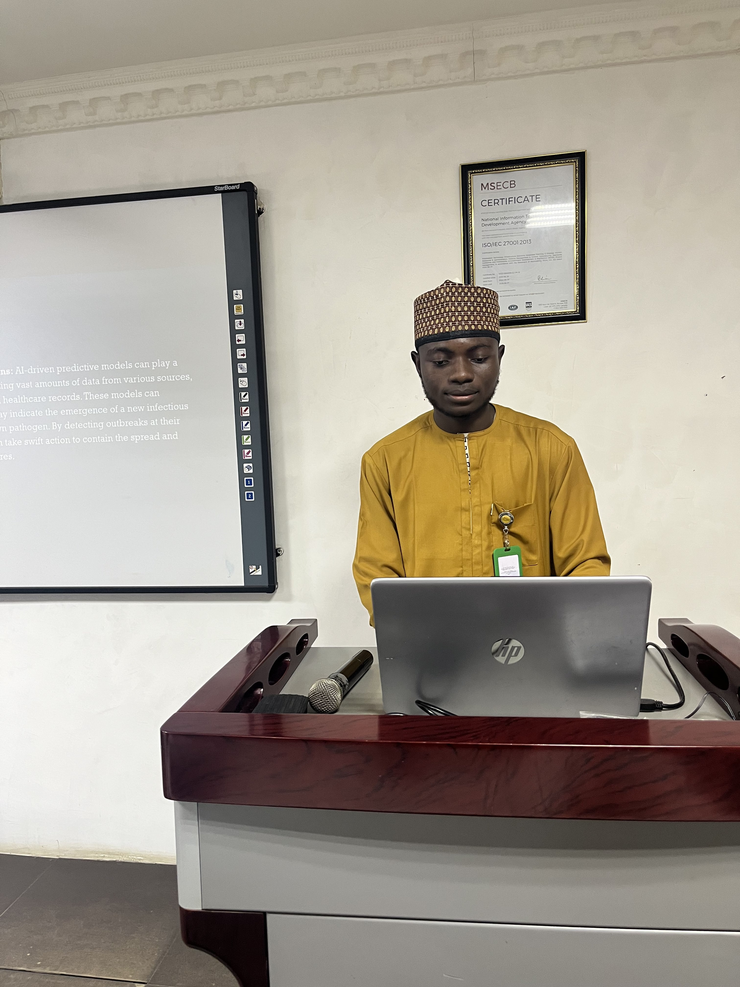
Employment Experience – NITDA Nigeria
Department: Digital Literacy & Capacity Development (DLCD)
Role: IT Support Specialist
Duration: 6 months
Key Contributions & Achievements:
Supported digital literacy programs across Nigeria.
Assisted in data analysis for NITDA’s Coursera scholarship (100,000+ beneficiaries).
Won NITDA Coursera Top Highflyer (Top 10) & ₦100,000.
Networked with industry leaders at Digital Nigeria Conference.

Slide 6
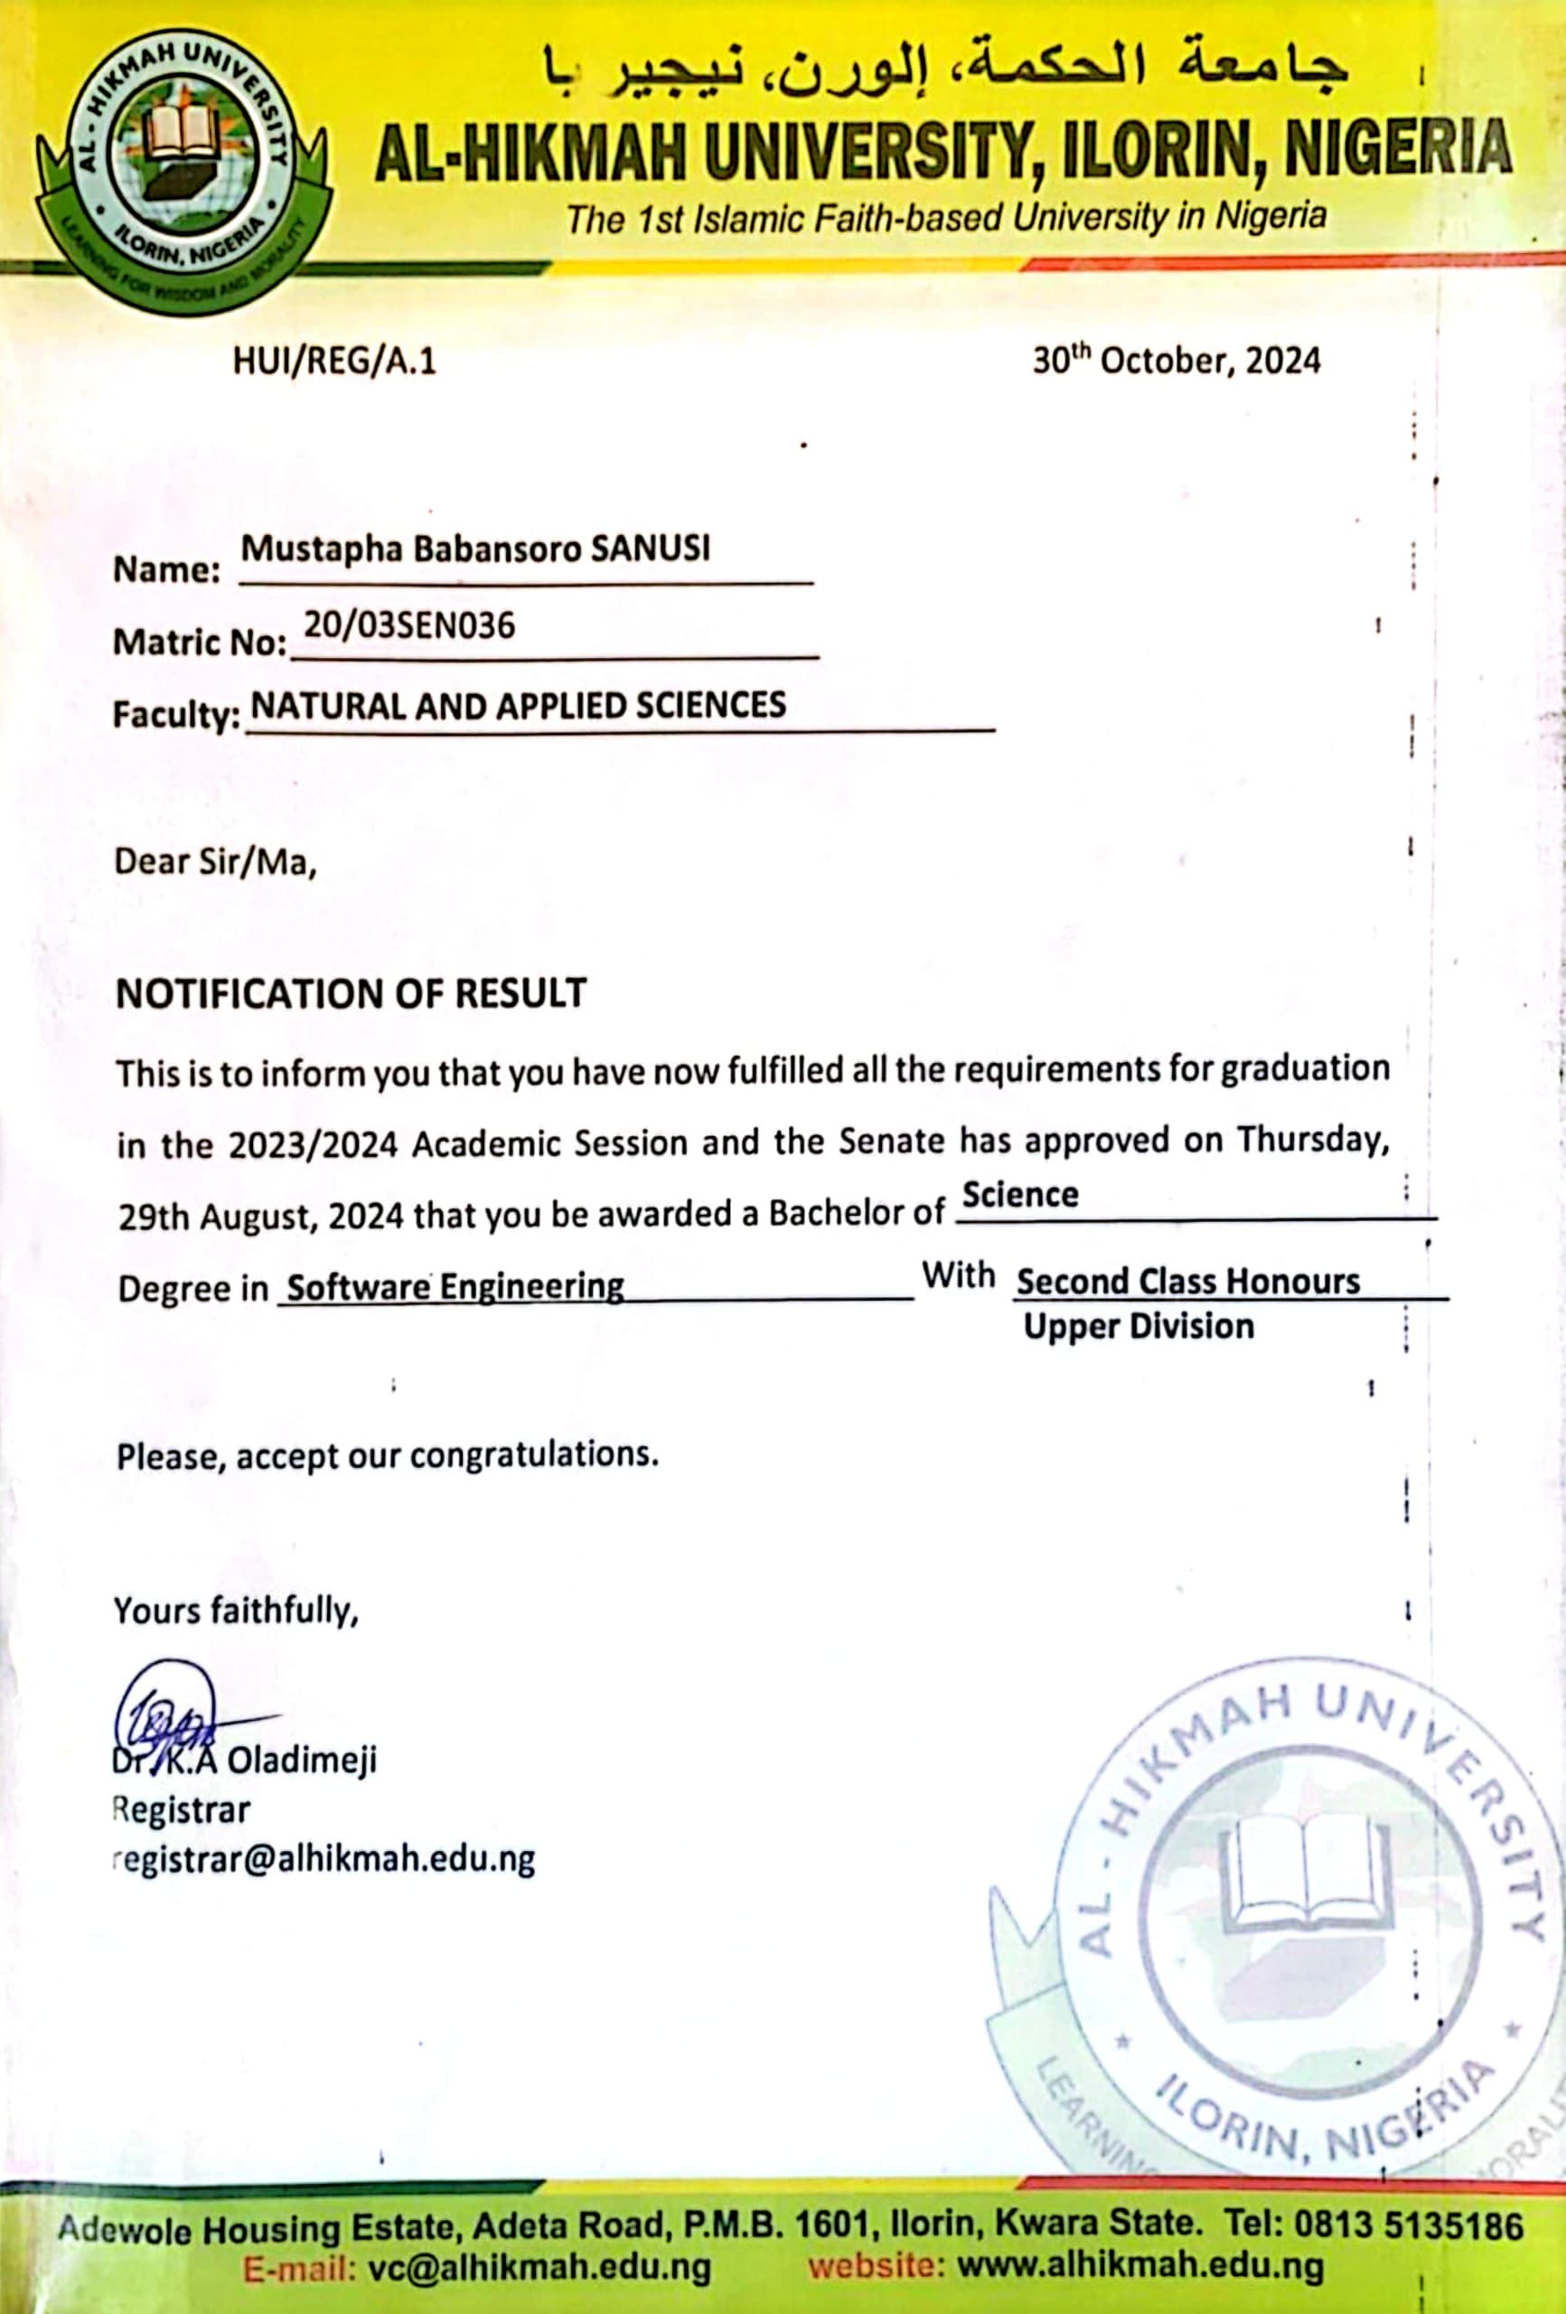
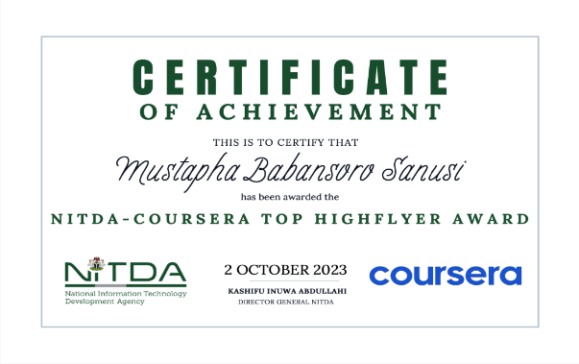

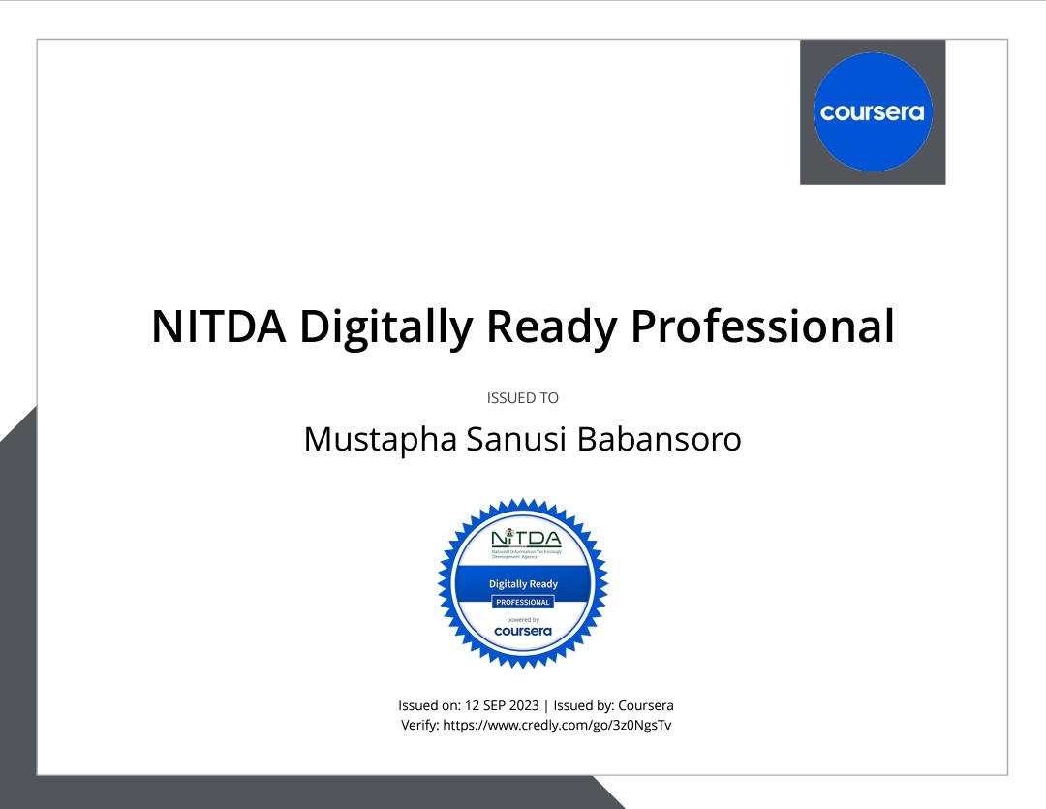
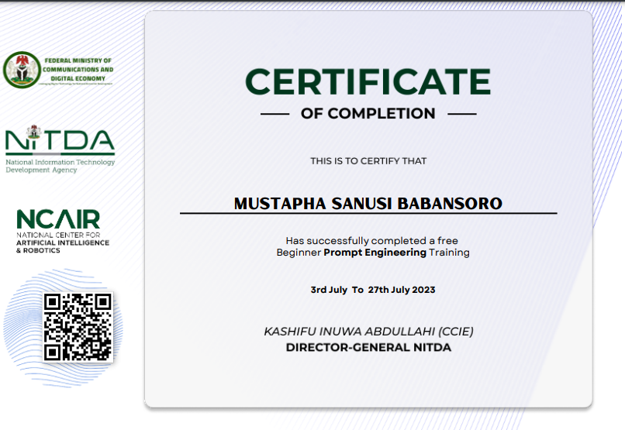
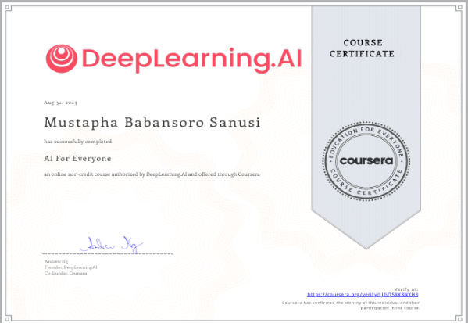
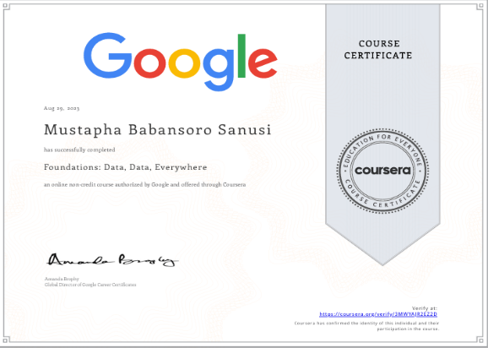
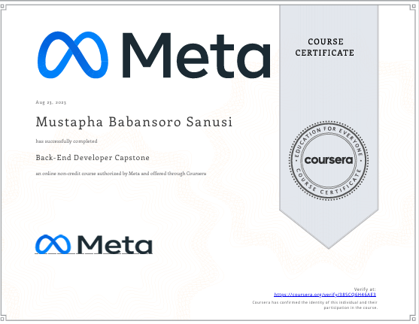
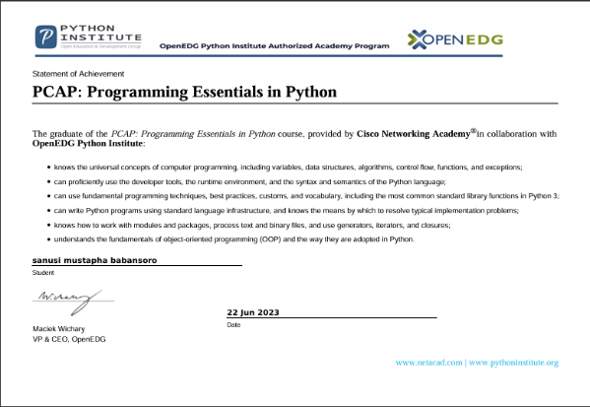
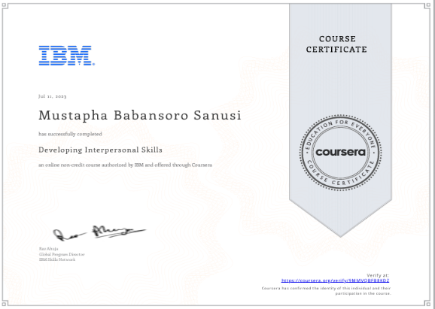
OUTSTANDING AWARD CERTIFICATES

Slide 7
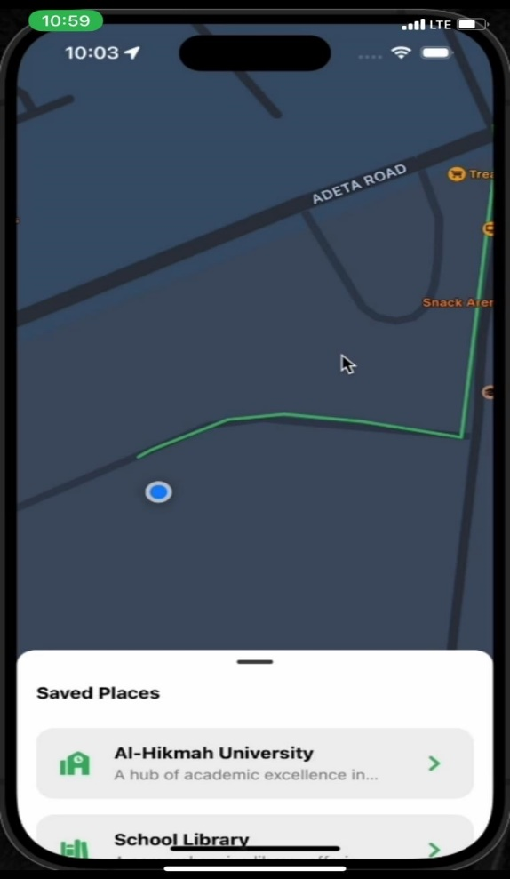
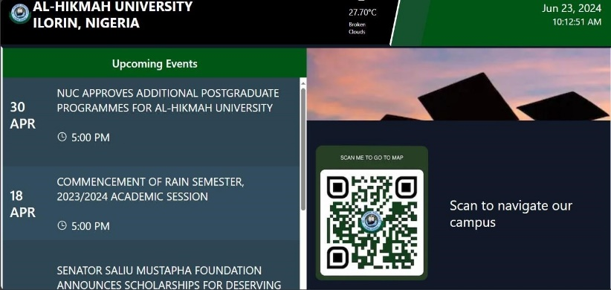
PROJECT (Campus Navigation & Display System)
Objective: Designed a Navigation & Interactive Digital display system for navigating through the school campus, broadcasting announcements, schedules, and emergency alerts to students and staff & visitors.
Impact:
Improved Navigation, quick announcement and removed the need to rely on verbal directions to visitors and new students
Technologies Used: Javascript| React-Native | Google Maps API
Publication:
Sanusi, M.B & Muhammad M.M 2025). Campus Navigation and Dynamic Display System Using React-Native and Next.JS 'Journal of Software Impacts ’(under review)

Slide 8

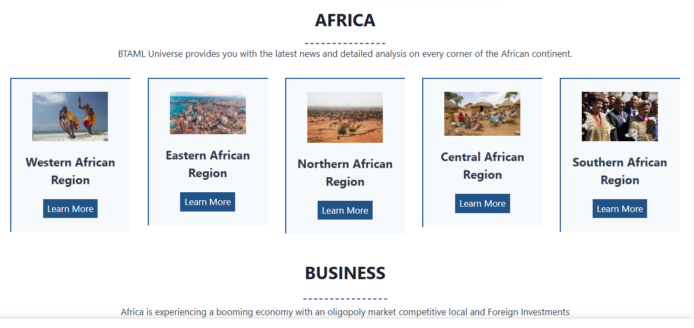
PROJECTS (Business Website)
BTAML Universe
Objective: Developed a professional website for BTAML Universe
Technologies Used:
Python (Django) | Frontend Technologies | AWS
Impacts:
Created an interactive platform for foreign investors to access research insight and Built a strong digital presence for BTAML Enterprise.

Slide 9
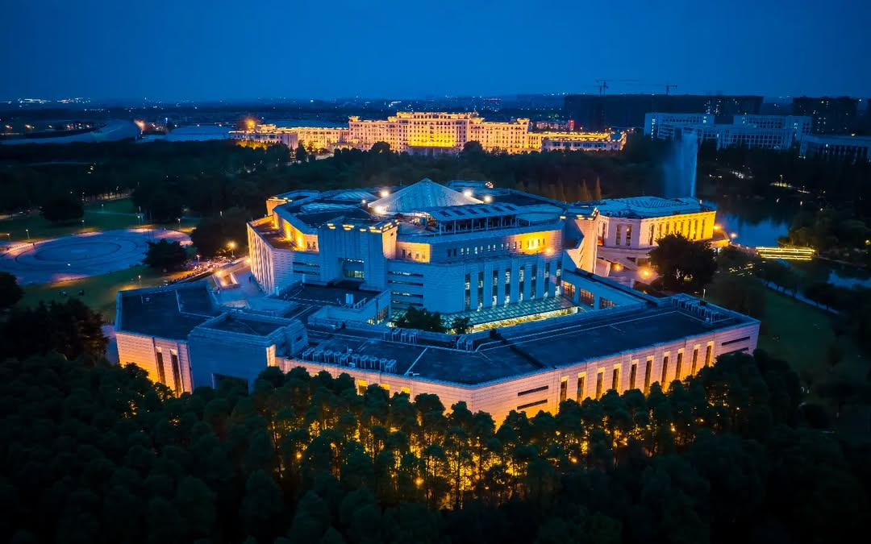
WHY UESTC
Top Ranked: in the World
Research Fit: AI, ML, Big Data & CS
Expert Supervision: Prof. Sun Guolin
Advanced Facilities: AI research centers
Global Recognition: Industry collaborations
Diverse Community: Innovation driven research
Scholarship: Funding for international students
Tech Hub City: Located in Chengdu, China

Slide 10
Masters. THESIS Plan:
Topic: Optimizing End-to-End Deep Learning Pipelines for Big Data Analytics
Name: Sanusi, Mustapha Babansoro
Prospective Supervisor: Prof. Sun Guolin

Slide 11
OVERVIEW
Challenge (Traditional Pipeline) | Solution (Optimized Pipeline)
Traditional pipelines struggle with large data volumes, causing high latency due to slow data ingestion and transformation, while manual interventions further reduce efficiency. | Optimized pipelines utilize scalable deep learning, parallel processing, and automated data ingestion to enhance speed, scalability, and real-time AI model updates.
Why It Matters:
Optimized pipelines enhance real-time analytics and decision-making by reducing latency and improving AI/ML model accuracy. Inefficient pipelines lead to slow processing, bottlenecks, and poor model performance.
Research Objectives & Approach:
Develop scalable Deep Learning pipelines, optimize data ingestion, validate performance.
Test on real-world big data and evaluate using case studies & cloud applications.

Slide 12
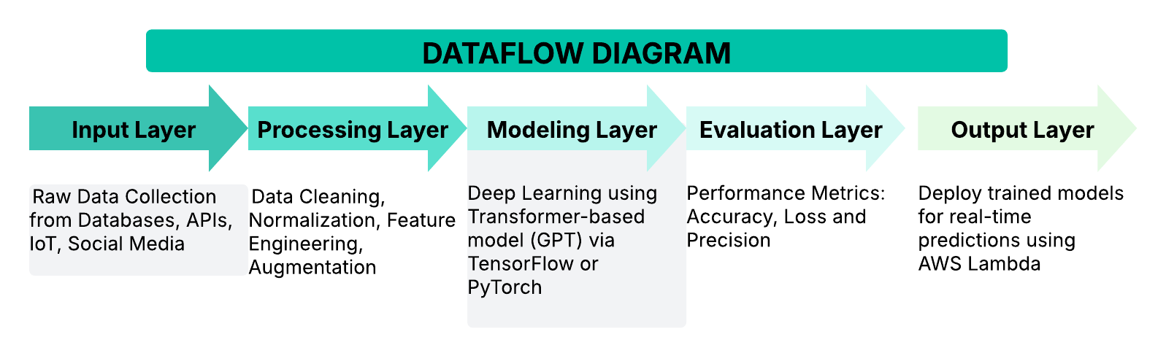
METHODOLOGY
DATAFLOW DIAGRAM

Slide 13
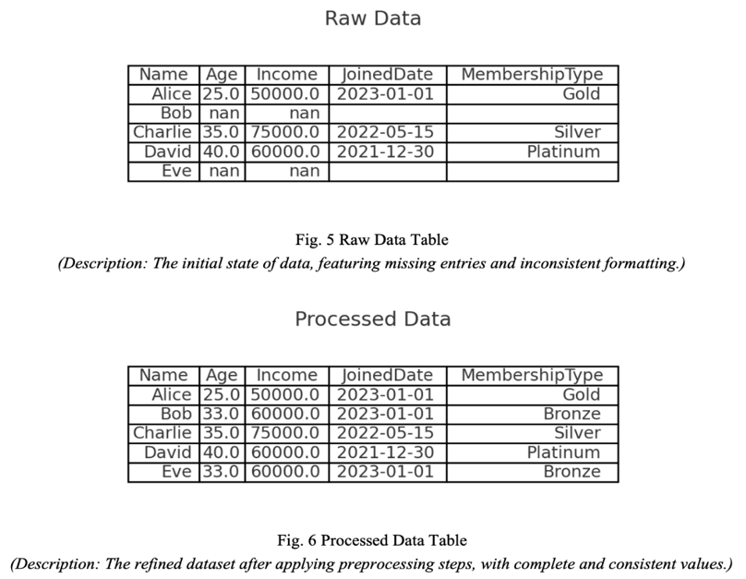
Illustration of Data Cleaning and Transformation
Figure 5 & 6 illustrate raw data transformation into structured datasets. Cleaning steps like handling missing values & standardization enhance data quality, ensuring deep learning models extract patterns effectively for accurate predictions.

Slide 14
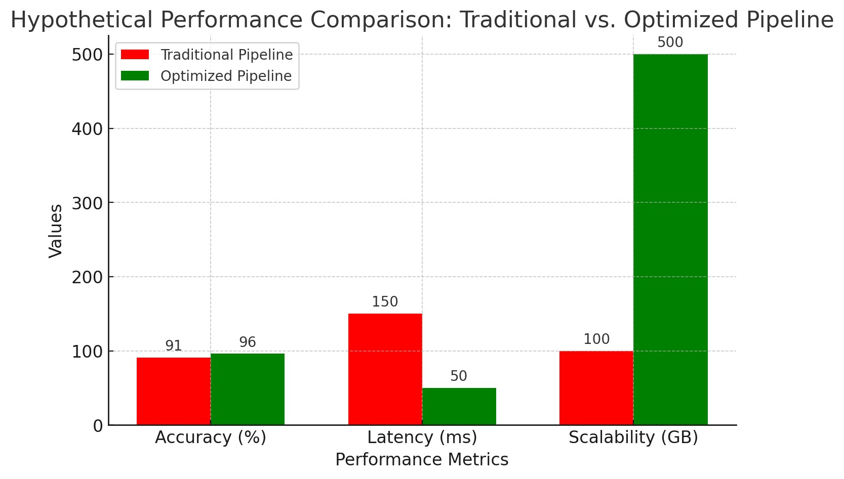
PERFORMANCE COMPARISON
For the performance evaluation, I use a hypothetical dataset simulating real-world big data scenarios, ranging from 10GB to 100GB, to test scalability, efficiency, and AI model accuracy.
Note: Hypothetical data used for illustration purposes.

Slide 15





EXPECTED CONTRIBUTIONS & REAL-WORLD IMPACT
Optimizing Pipelines for Big Data
Scalability: Real-time deep learning pipeline.
Efficiency: Reduced latency, faster AI predictions.
Automation: Fully automated AI model deployment.
Real-World Applications
Healthcare: AI-driven medical diagnostics & real-time patient monitoring.
Finance: Fraud detection & risk analysis using real-time big data processing.
Smart Cities: Optimized traffic management & predictive analytics for urban planning.
Manufacturing: Automated quality control using real-time AI-powered detection.

Slide 16
CONCLUSION
The prospect of pursuing Masters in Computer Science at UESTC aligns perfectly with my academic and professional aspirations.
The program's focus on AI, machine learning, and data science makes it the ideal place for my growth.
I am confident that my background, skills, and dedication align with UESTC's values and goals.
I am excited about the opportunity to contribute to the academic community and further my studies in the field of AI and Computer Science.

Slide 17
感谢聆听
THANK YOU FOR YOUR TIME

